Slide 1
“Working the Net” for Mission
Kristin Hokanson SNDdeN

Slide 2
Notre Dame Virtual School
In the schools teach whatever is necessary
to equip the students for life.
St. Julie Billiart
Online
Resources
Organizational
Memberships
NDVS
Social Media
Resources
Notre Dame
Online
Global
Networking
Notes:
Document Research:
NARSC:
A suggestion for organizing various functions of the National SND Communications System:
Visual Function: graphic design, pre-press functions, printed material, electronic materials, photography, multi-media materials, website materials (management))
Writing and Translation Function: press releases, copy for documents, letters, etc)
Record/Database Function: Data Bases: SNDs, Ministry, Inquiries, Donors, Arch/Diocesan, Schools, Media Sources (newspapers, TV, radio, Archives, etc
Public Relations and Media Function: (Internal for Internal, Internal for External, External for Internal, External for External)
Technology Function: FirstClass, E-mail, web, teleconferencing, live-broadcasting, etc.)
Quality Control Function: Printed Materials, Electronic Materials, Virtual Materials, Web Site Materials, Audio Materials, Broadcast Materials)

Slide 3
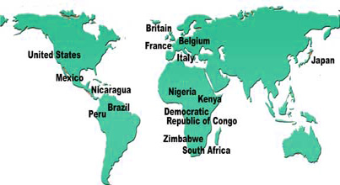
Networking Schools

Slide 4
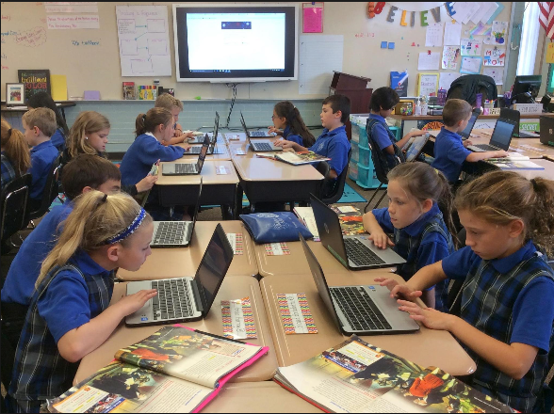
Haven’t classrooms changed?
1960s
Today

Slide 5
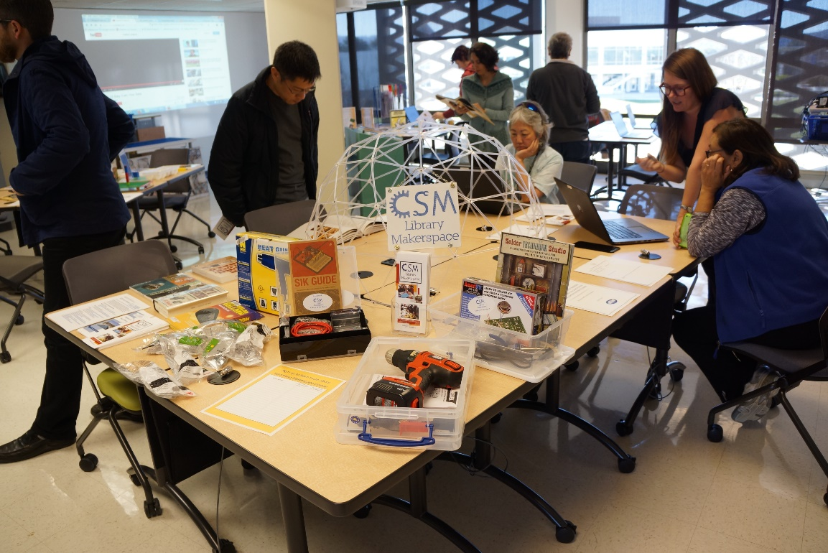
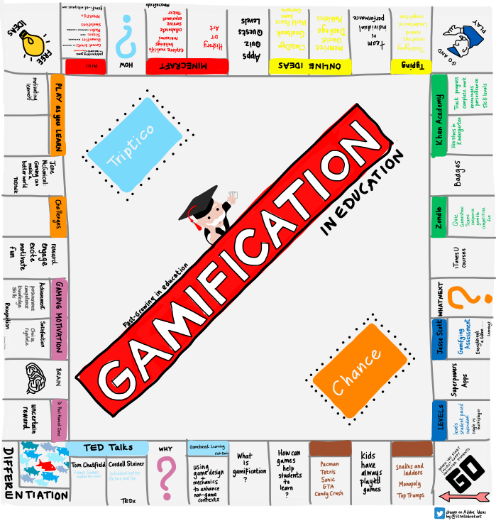
Makerspace
Gamification

Slide 6
Online Resources

Slide 7
Online Resources
NDVS Intranet Services
Learning Webs
St Julie Project
Cloud Storage eRooms
Online Tutoring
Professional Development
St Julie Book (online)
Networking
Virtual High School

Slide 8
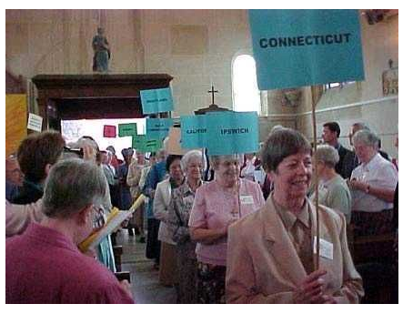

Slide 9
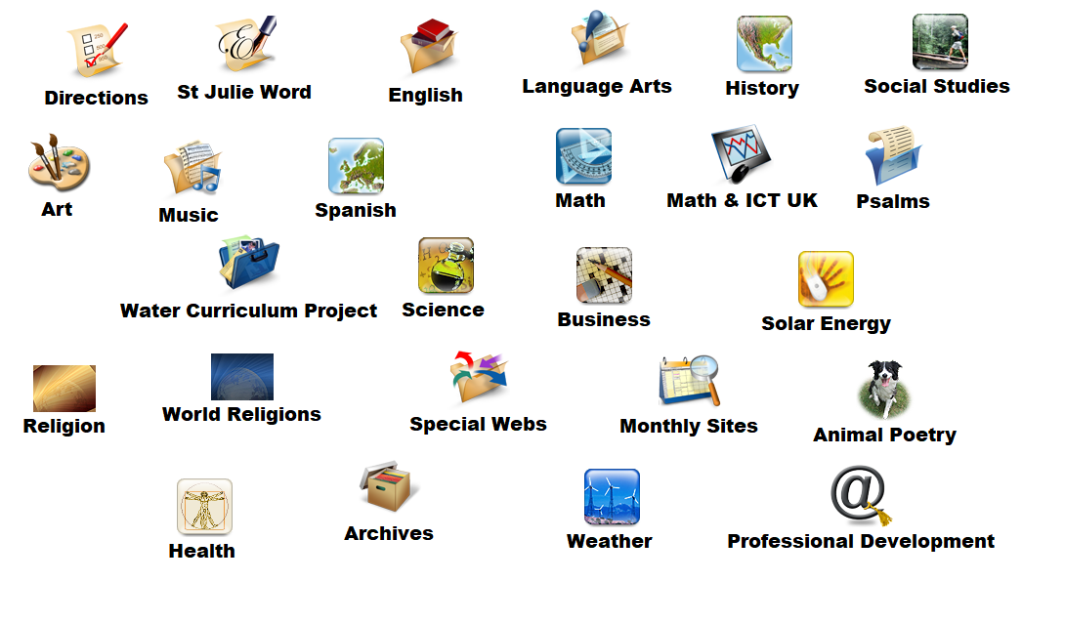
NDVS Learning Webs and Units

Slide 10
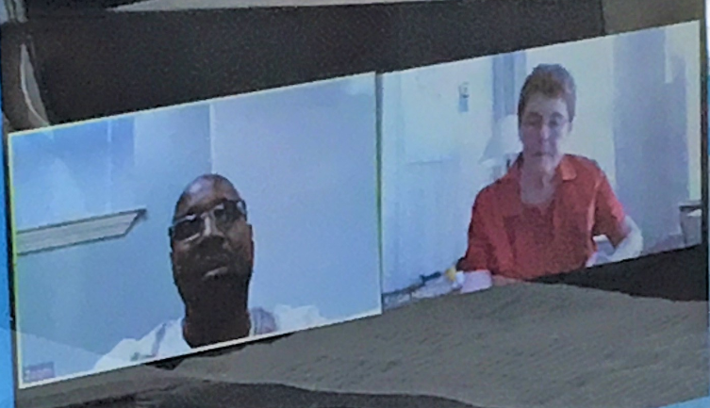
Citizenship Online Tutoring

Slide 11
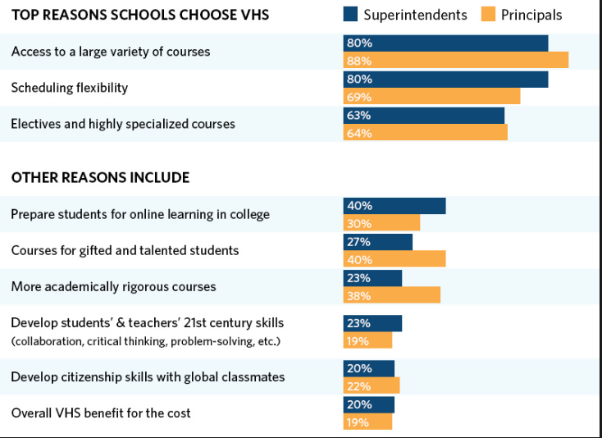

Slide 12
Notre Dame Online

Slide 13
Notre Dame Online
CMO Communications Team
Sustainable Development Goals
Curriculum
St Julie Resources
Dorothy Stang Resources
Photovoltaic Project

Slide 14
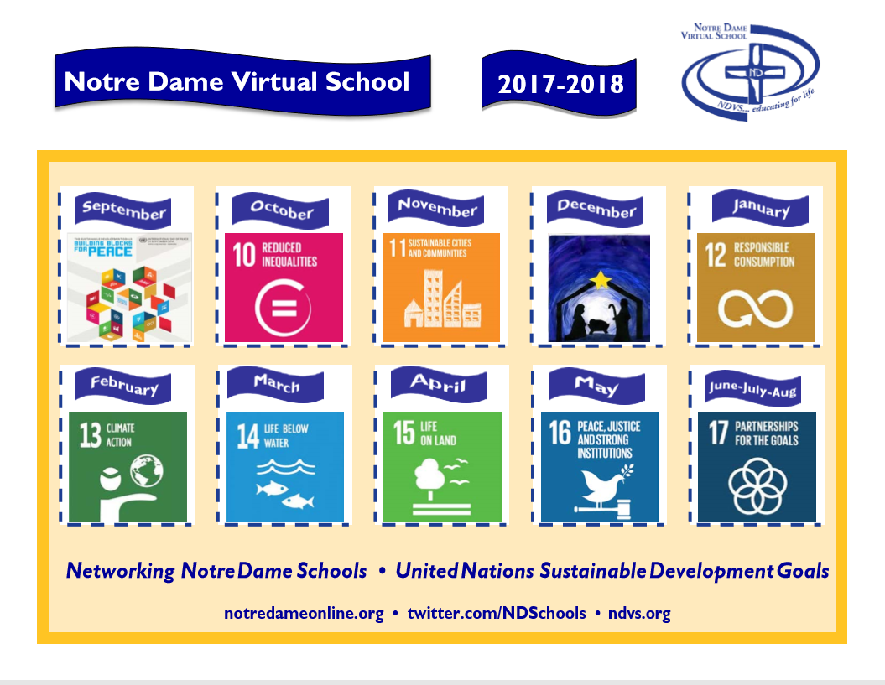

Slide 16
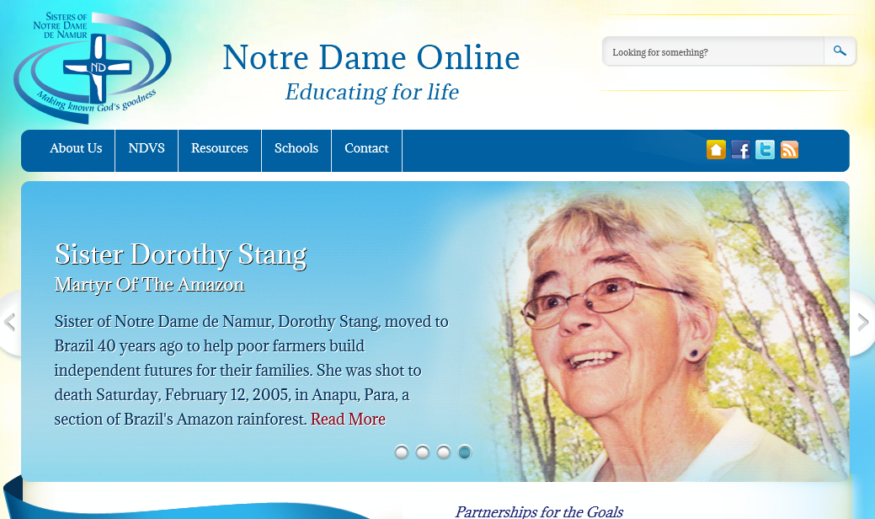

Slide 18
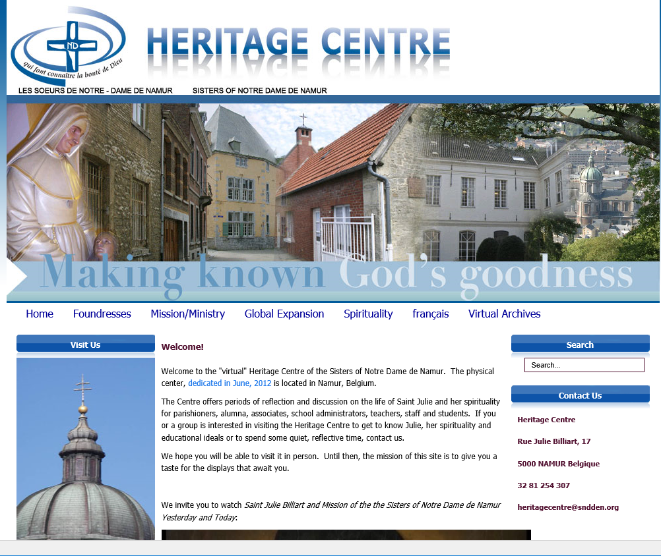

Slide 19
Organizational Memberships

Slide 20
Organizational Resources
Education for Justice
edWeb.net edX.org
ISTE Professional Learning Networks
Digital Citizenship
Digital Library of America
CAFOD
Zoom
eSchools News
Common Sense Media

Slide 23
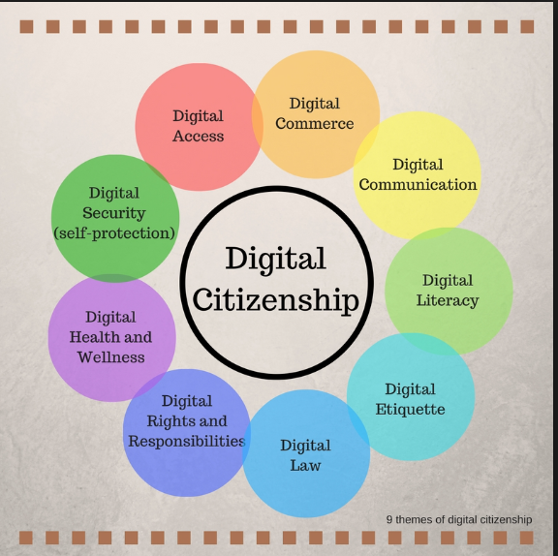

Slide 24
International Society for Technology
in Education
Professional Learning Networks (PLN)
Digital Citizenship
Librarians and Media Specialists
International Schools
Online Learning
Global Collaboration
STEM
Independent School Educators

Slide 27
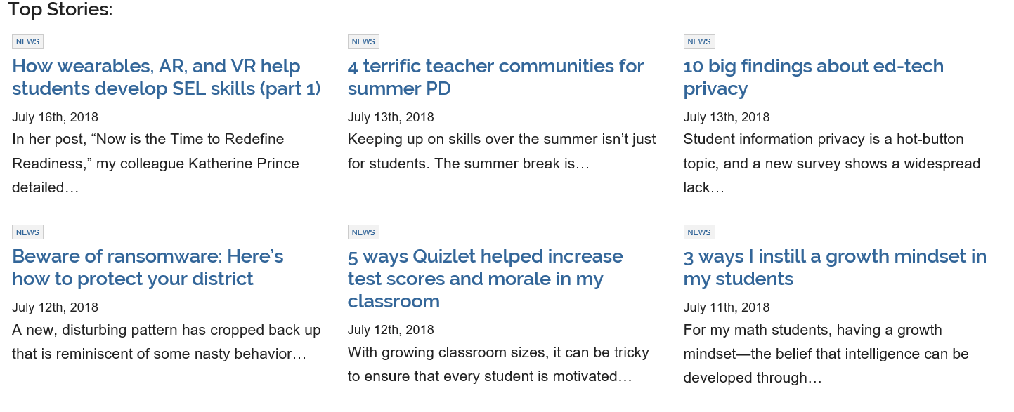

Slide 29
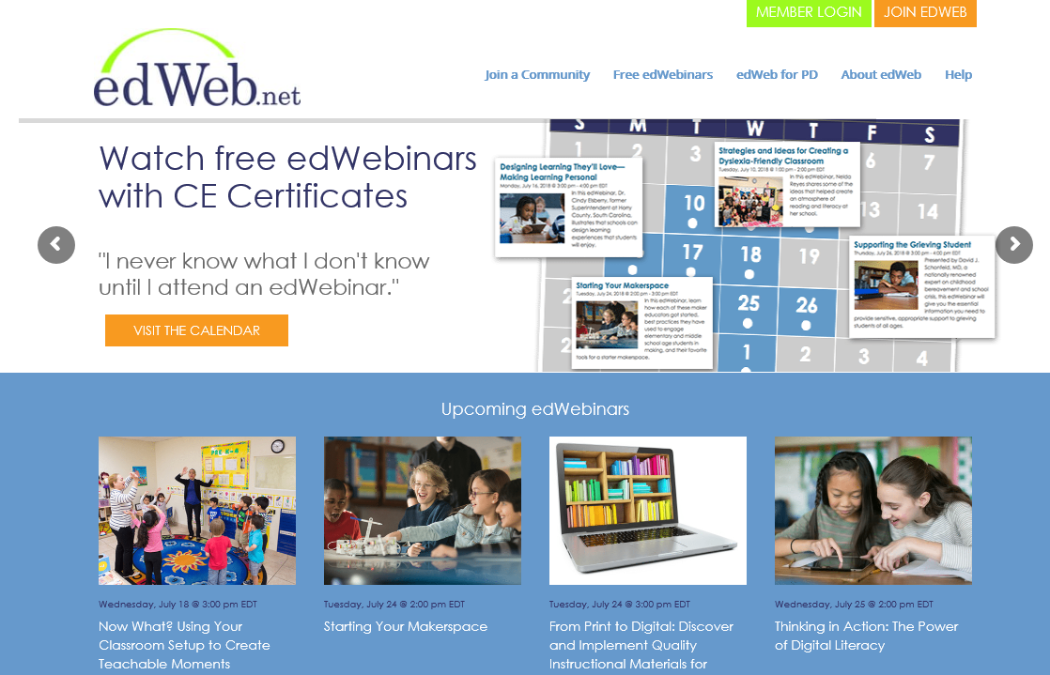

Slide 31
Social Media

Slide 32
Social Media
SNDdeN Websites
SNDdeN Twitter sites
SNDdeN Facebook sites
Twitter @NDSchools #NDSchools
New initiative: @StJulie2Day

Slide 33
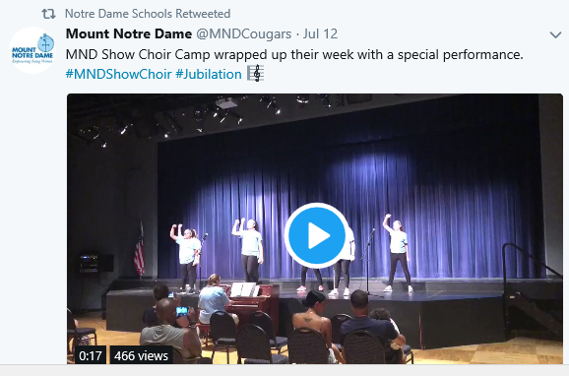
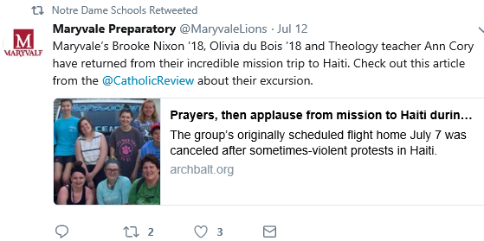

Slide 34
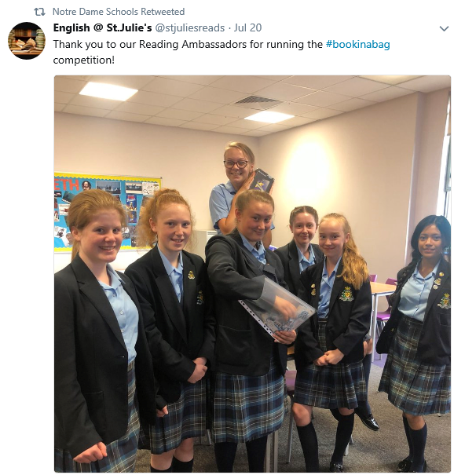
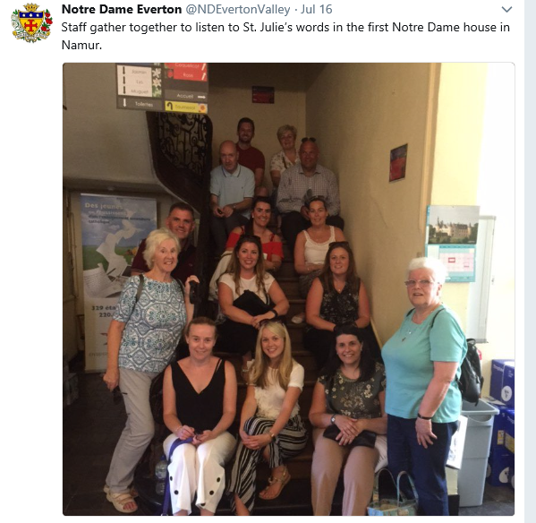

Slide 35
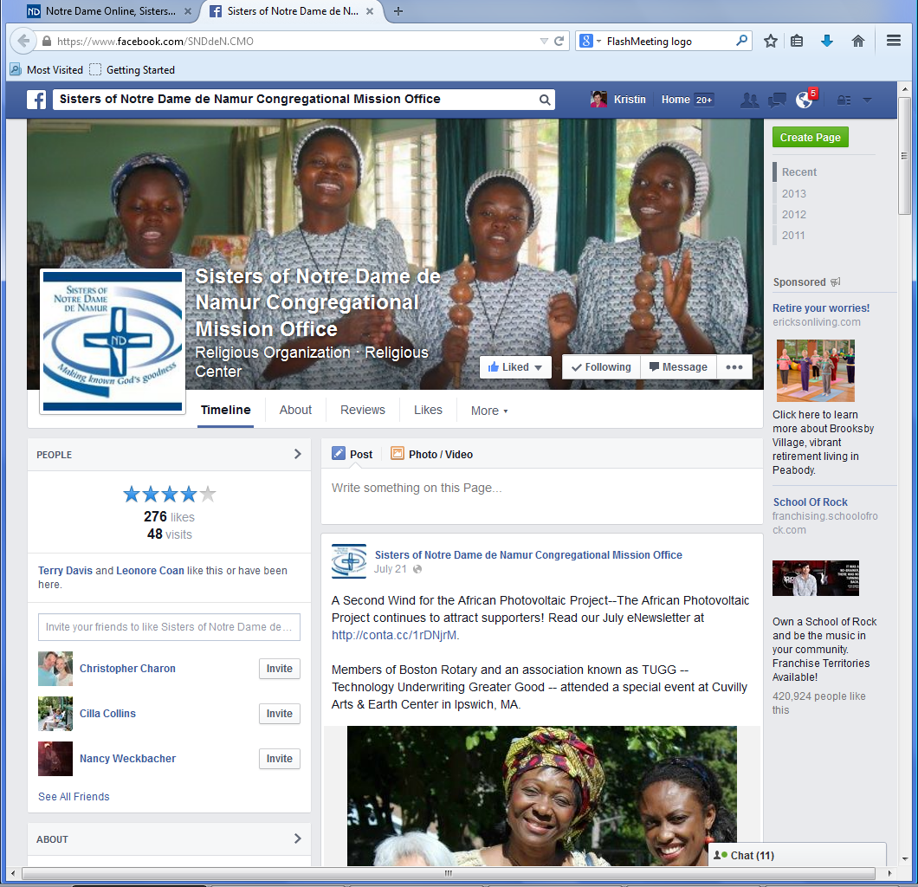

Slide 36
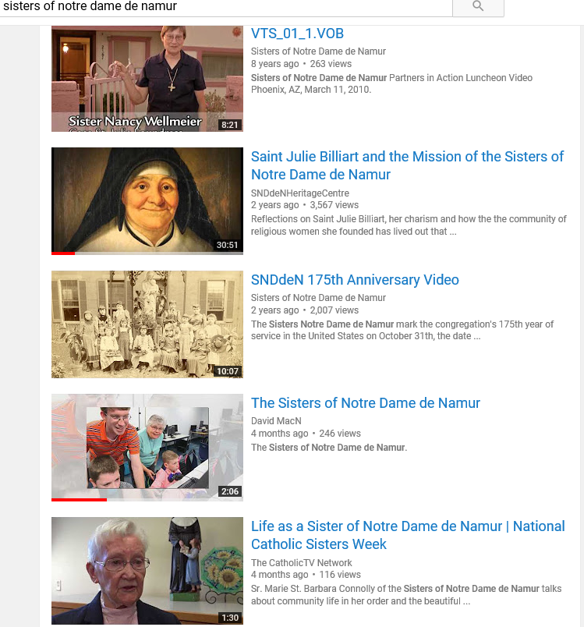

Slide 37
Global Networking

Slide 38
Global Networking
Africa Schools
Retreats
Japan Schools
Video Prayer Services
Flat Julie Project
1804 Society
International Travel
Promote Notre Dame Initiatives

Slide 39
Working the “Net” for Mission
What other areas would you like to see NDVS focus on?

